Slide 1
KDJK Project Report
Group No.2

Slide 2
Group Member
00000012157 | GERRY | SUCIPTO
00000016528 | BRYAN | YEHEZKIEL
00000012566 | FERONIA | MEILINDA
00000012778 | HENDRIAN | LUNARDI
00000019043 | MARCEL | PRASETIA
00000012311 | RICKHEN | HERMAWAN
00000012383 | SAMUEL | SETIADI
00000012273 | SUDONO | TANJUNG
00000012343 | VERI | GUNAWAN

Slide 3
TimeTable
Day / Time | Activity | Description
24/03/2017 | Meeting | Want to know about source code about client and server
27/03/2017 | Meeting | what must we do to adding feature
31/03/2017 | Private chat (Whisper) | Adding private chat as whisper
4/04/2017 | Online User | Show online user after on of client has been disconect
10/04/2017 | Send files privately | Send file certainly to specific client
6/04/2017 | Modifying JLabel (“Techworld3g”) | Modify JLabel(“techworld3g”) to client name
11/04/2017 | Modify Server and Client GUI | Modify GUI to make more tidy
15/04/2017 | Fixed send file privately | The latest file send only send file that are only coverted to string and now the client can
17/04/2017 | Show online user in GUI | Show list of users who are online

Slide 4
Work Division
GitHub link : https://github.com/sudtanj/Client-Server_Chat

Slide 5
Work Division
Gerry Sucipto :
Coding for feature number 2 and 3
Coordinate all groub member
Help to make ppt and doc for project assignment
Sudono Tanjung
Coding for feature number 1
Help to make ppt and doc for project assignment
Samuel Teguh
Coding for feature number 4
Help to make ppt and doc for project assignment

Slide 6
Work Division
Veri Gunawan
Helps with the coding work of feature number 4
Make Doc
Learn the theories that are related to chat client server
Marcel Cahya Prasetia
Helps with the coding work of feature number 4
Make Doc
Learn the theories that are related to chat client server
Rickhen Hermawan
Helps with the coding work of feature number 1
Make Doc
Learn the theories that are related to chat client server

Slide 7
Work Division
Bryan Christofel
Helps with the coding work of feature number 4
Make PPT
Learn the theories that are related to chat client server
Hendrian Lunardi
Helps with the coding work of feature number 2
Make PPT
Learn the theories that are related to chat client server
Feronia Meilinda
Helps with the coding work of feature number 1
Make PPT
Learn the theories that are related to chat client server

Slide 8
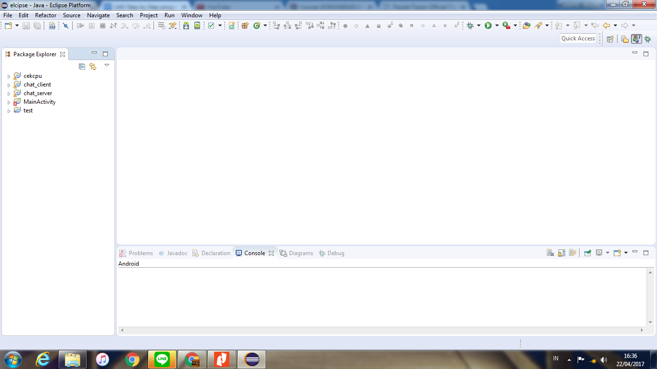
Step Running the Chat
Typing NetBeans or Eclipse in Windows search bar and open it.

Slide 9
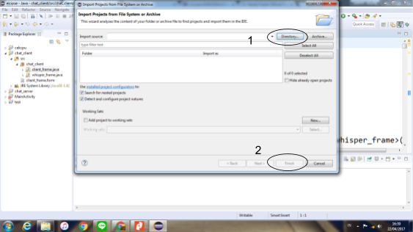
Step Running the Chat
Click File => Open Projects and find your project in your directory

Slide 10
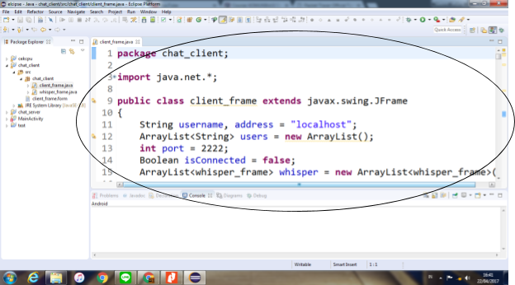
Step Running the Chat
Once the project is fully loaded, the file that has extension .java will appear on screen with the code

Slide 11
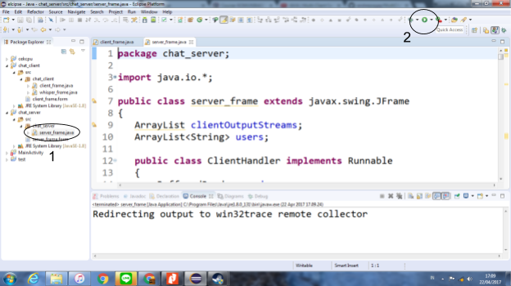
Step Running the Chat
Choose the server_frame.java and click run button as example below

Slide 12
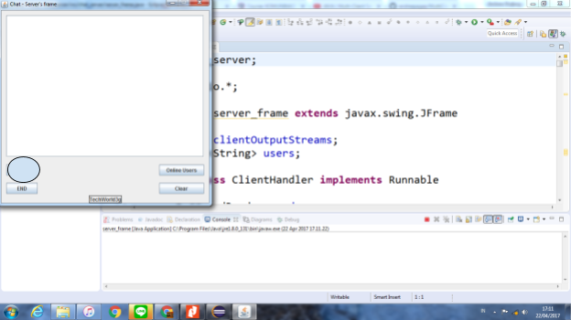
Step Running the Chat
Click the start button as example below

Slide 13
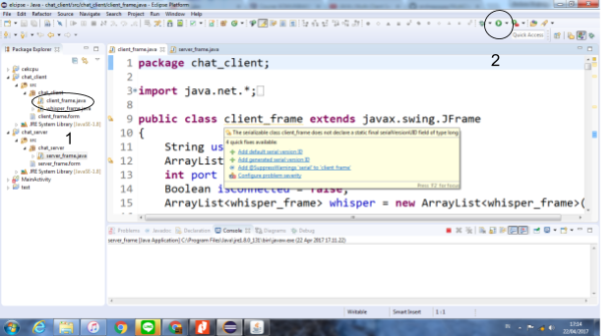
Step Running the Chat
Choose the client_frame.java and click run button as example below

Slide 14
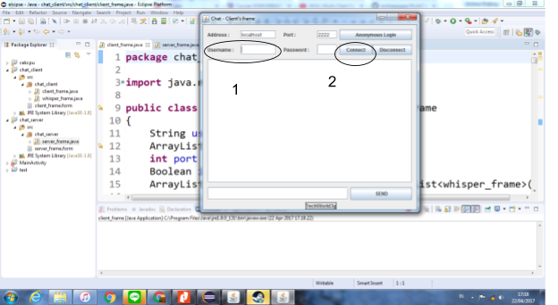
Step Running the Chat
Type the username in the username box provided and click connect

Slide 15
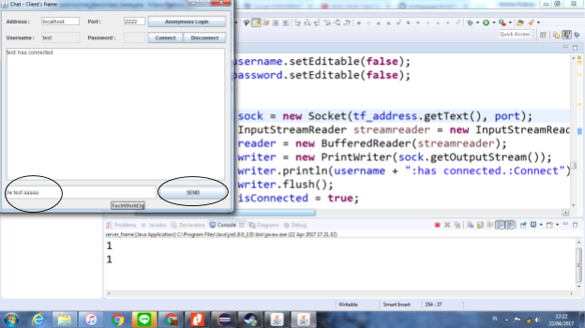
Step Running the Chat [Whisper]
After connected, please type /w [username] [message] then click send

Slide 16
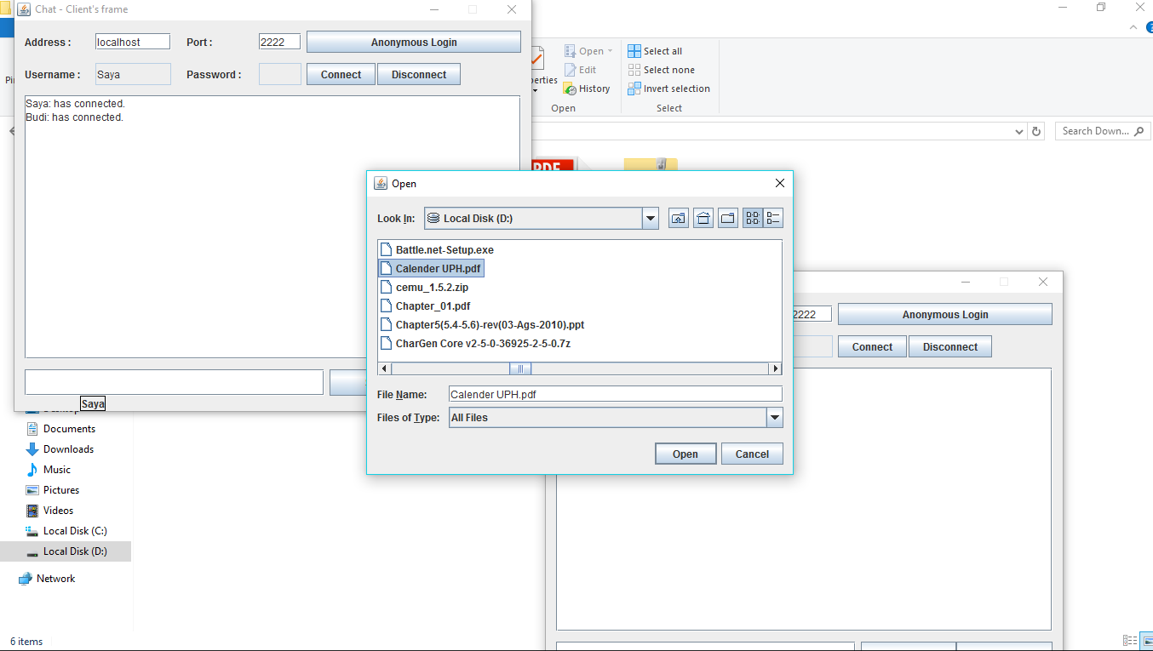
Step Running the Chat [Attach File]
Click Attach and choose the file you want to send

Slide 17
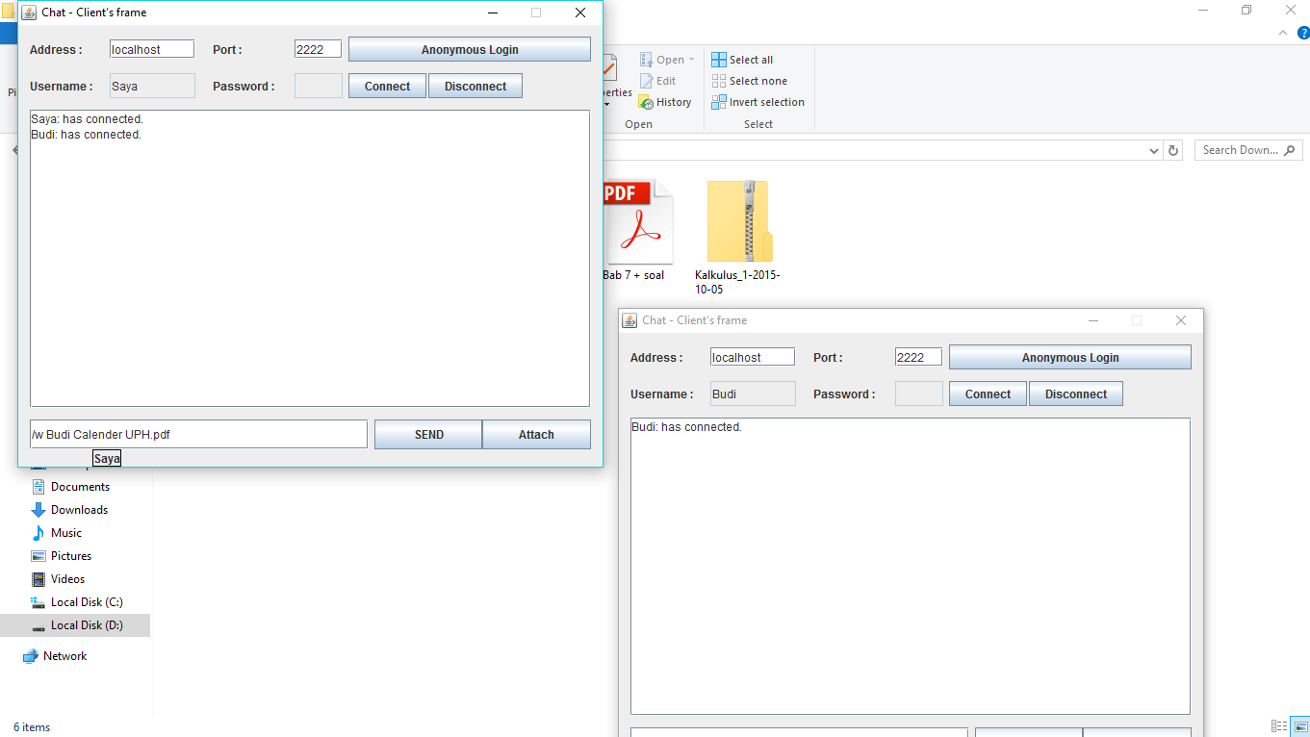
Step Running the Chat [Attach File]
Replace [username target here] with the username you want to send the file to and Click Send

Slide 18
Feature Already Included
Private chatting (Whispering )
Show Online User before and after user disconect
Different name per client_frame
Send file privately
Show online user in GUI

Slide 19
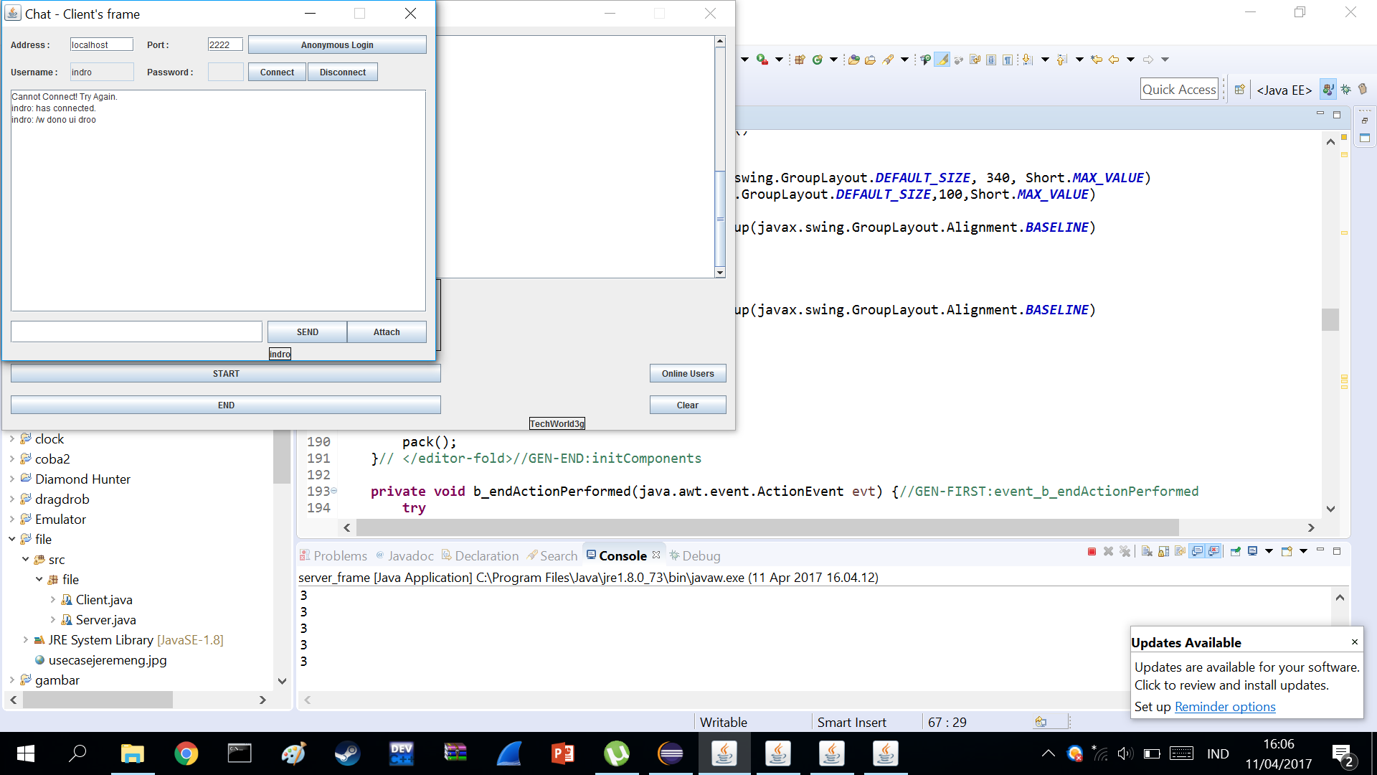
1.Private Message

Slide 20
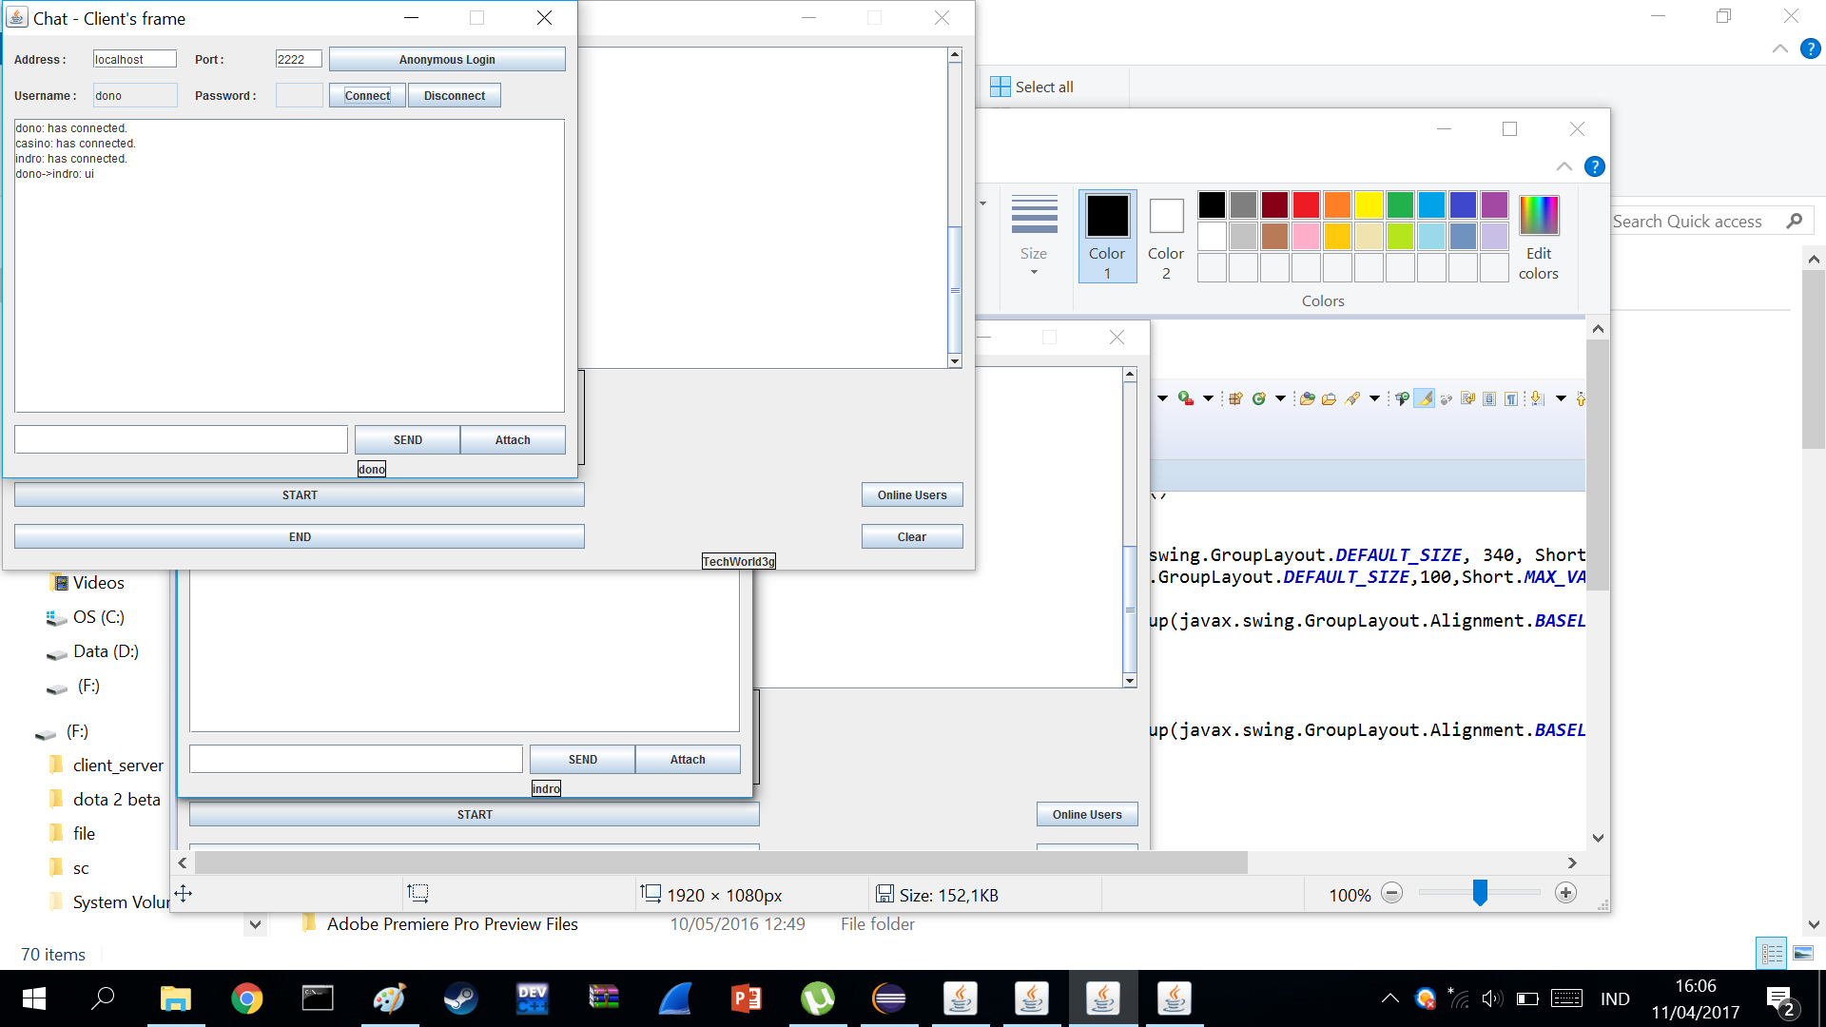
1.Private Message

Slide 21
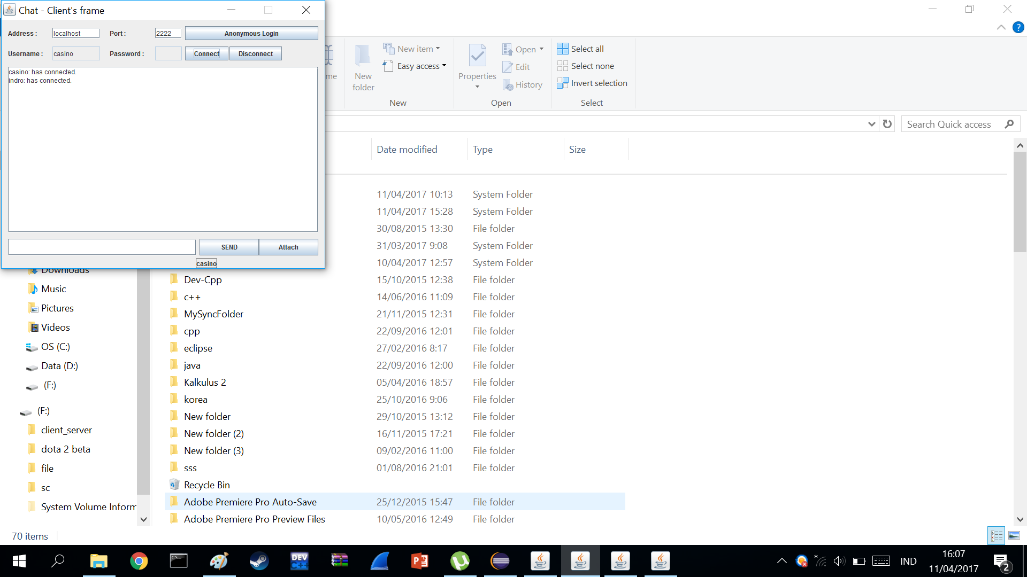
1.Private Message

Slide 22
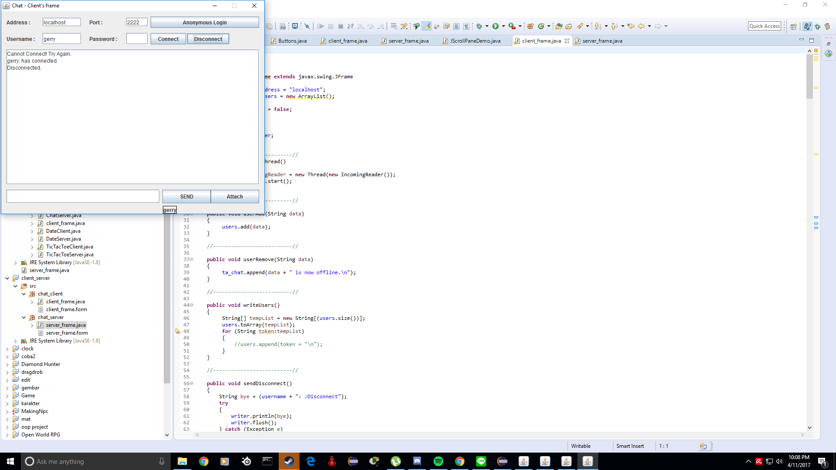
2. Online Users

Slide 23
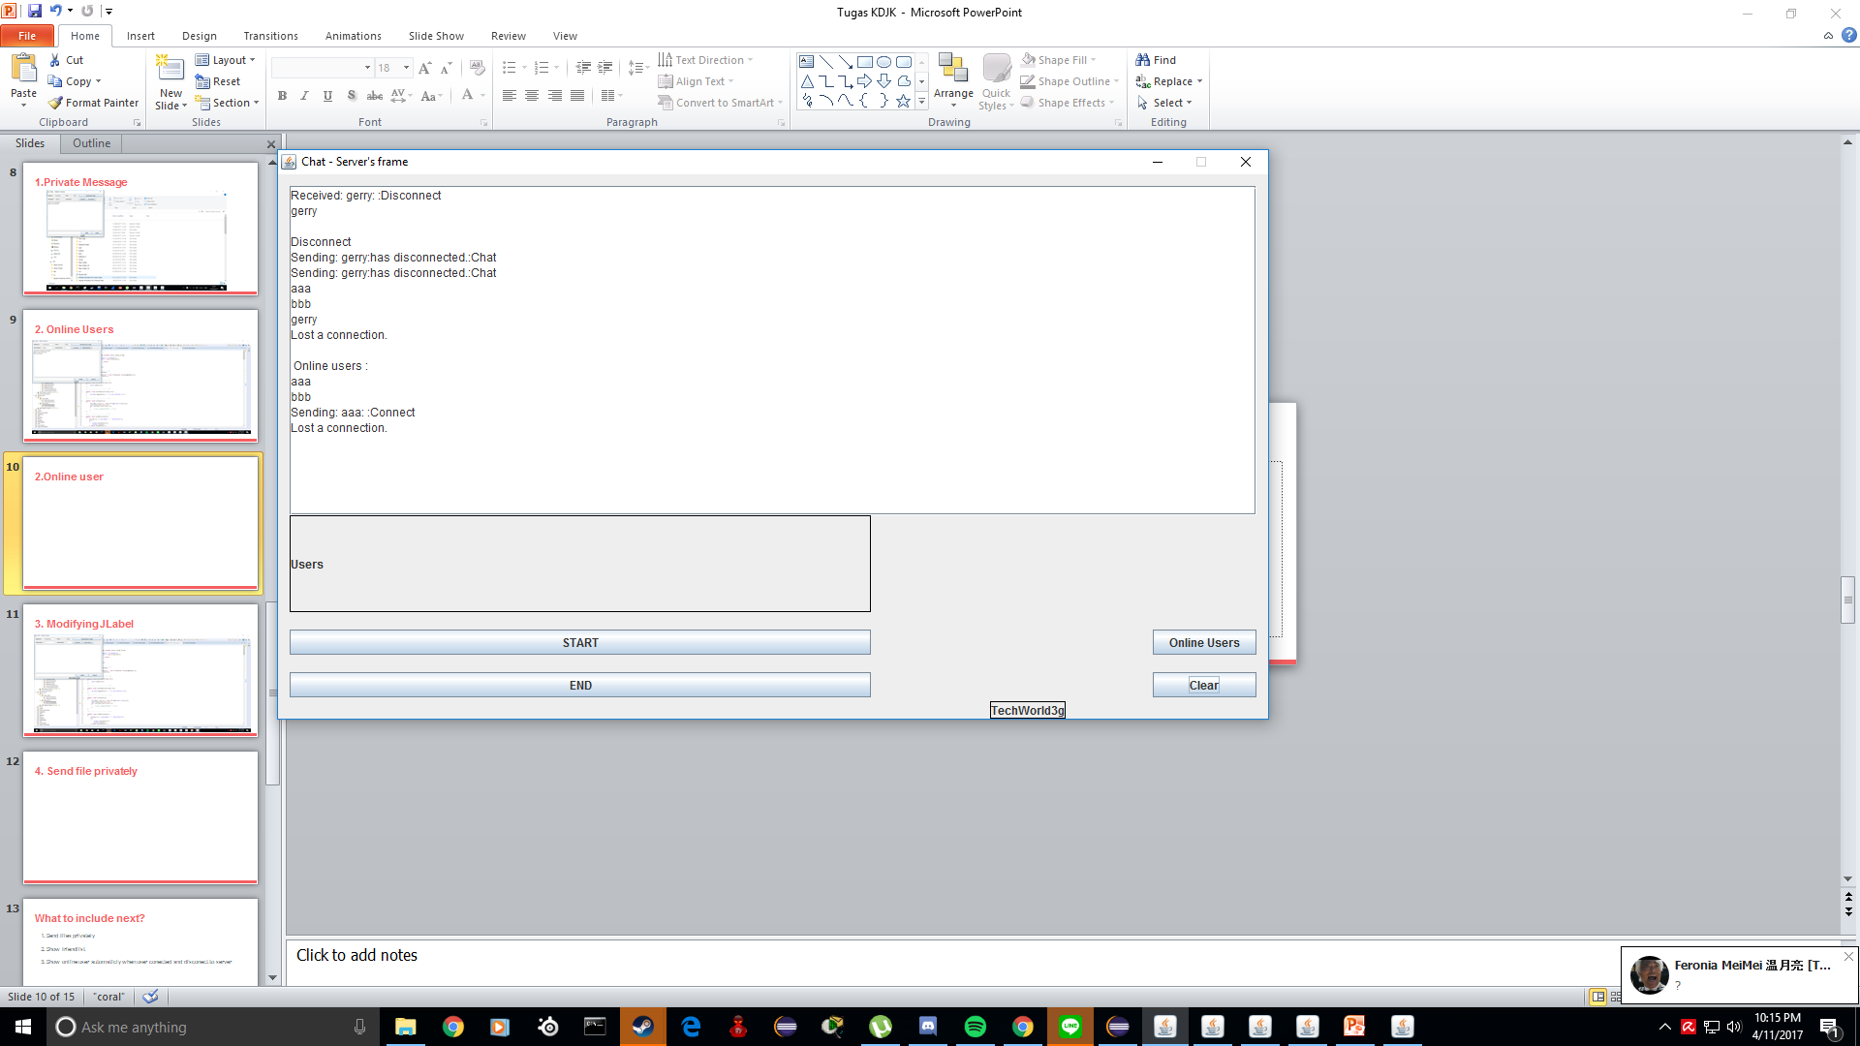
2.Online user

Slide 24
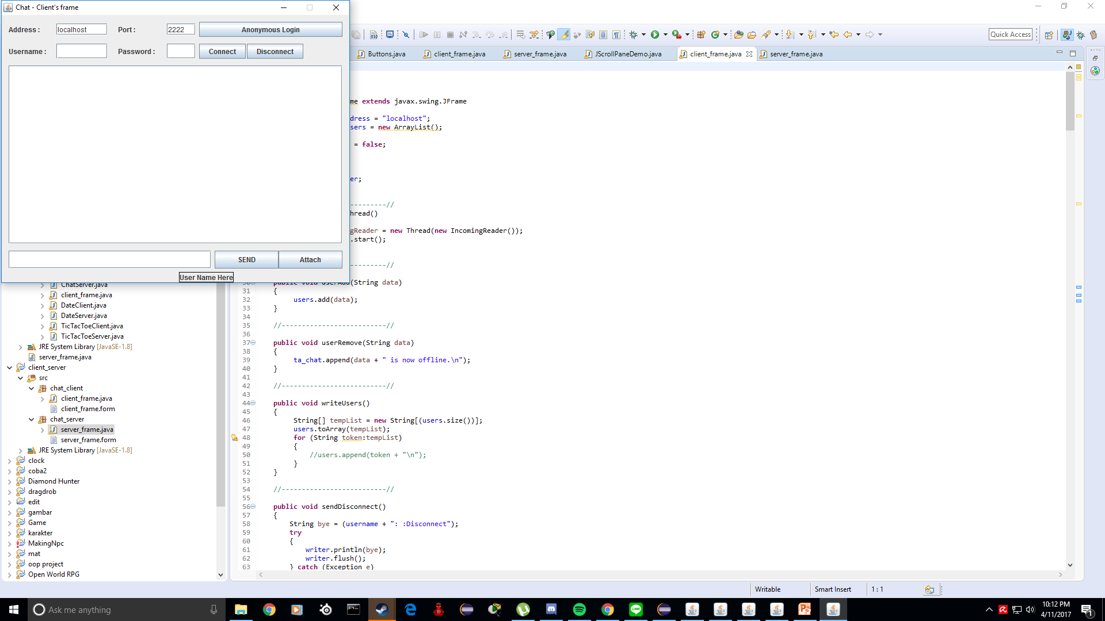
3. Modifying JLabel

Slide 25
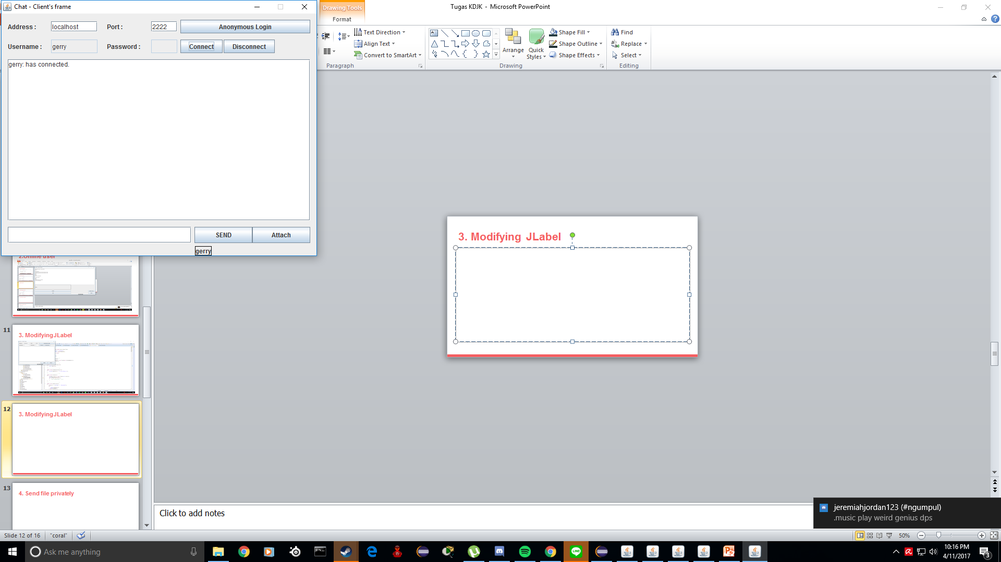
3. Modifying JLabel

Slide 26
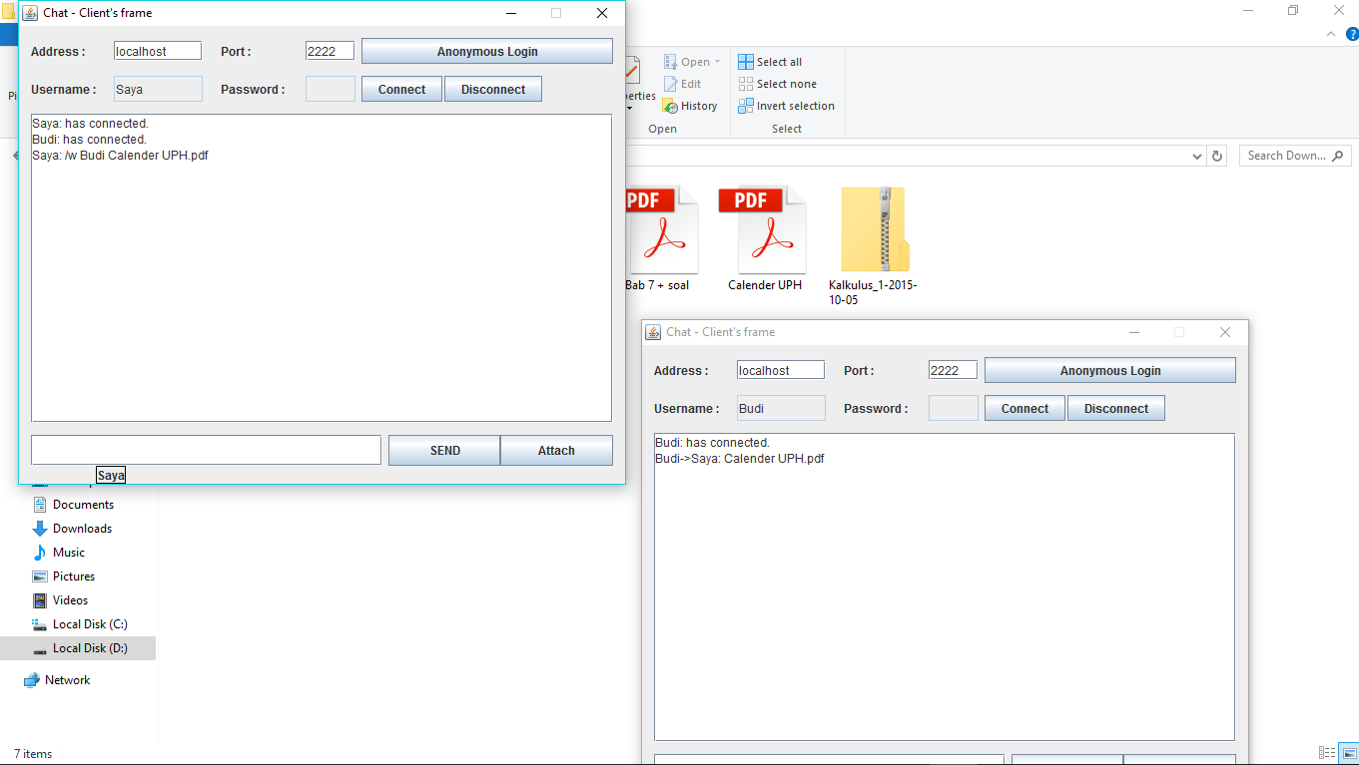
4. Send file privately

Slide 27
Technical Gains
Ability to add whispering system to the program
Ability to display online user
Ability to change JLabel (Swing Component)
Ability to do socket programming
Ability to open connection port

Slide 28
Refence
Refrence
https://docs.oracle.com/javase/7/docs/api/java/net/Socket.html
http://www.citethisforme.com/
https://docs.oracle.com/javase/7/docs/api/java/io/InputStream.html
http://stackoverflow.com/questions/9265719/print-arraylist
https://www.tutorialspoint.com/java/java_networking.htm
https://docs.oracle.com/javase/tutorial/networking/sockets/

